Slide 1
The Market for Foreign Exchange
Chapter Five

Slide 2
Overview
Money represents purchasing power
Market for foreign exchange is the largest financial market in the world by virtually any standard
Foreign exchange (FX) market encompasses the conversion of purchasing power from one currency into another, bank deposits of foreign currency, the extension of credit denominated in a foreign currency, foreign trade financing, trading in foreign currency options and futures contracts, and currency swaps
5-<number>

Slide 3
Function and Structure of FX Market
Function of FX market is to assist clients in the conduct of international commerce
  Service that commercial banks provide to their clients
Spot and forward FX markets are OTC markets, meaning trading does not take place in a central marketplace where buyers and sellers congregate
5-<number>

Slide 4
Function and Structure of FX Market
Major market segments
  Australasia: Sydney, Tokyo, Hong Kong, Singapore, and Bahrain
  Europe: Zurich, Frankfurt, Paris, Brussels, Amsterdam, and London
  North America: New York, Montreal, Toronto, Chicago, San Francisco, and Los Angeles
5-<number>

Slide 5
FX Market Participants
FX market is a two-tier market
  Interbank (wholesale) market
    International Banks
    Nonbank dealers
    FX brokers
    Central Banks
  Client (retail) market- bank customers
5-<number>

Slide 6
Five FX Market Participants
International banks (serve retail clients). About 150-250 banks worldwide stand ready to “make a market” in foreign exchange
Nonbank dealers (MFs, pension funds, hedge funds)
FX brokers: who match buy and sell orders but do not carry inventory and are FX specialists
Central banks (national monetary authority). Intervene using foreign exchange reserves to buy or sell their own currency to decrease or increase supply.
Customers (MNCs, money managers, private speculators)
5-<number>

Slide 7
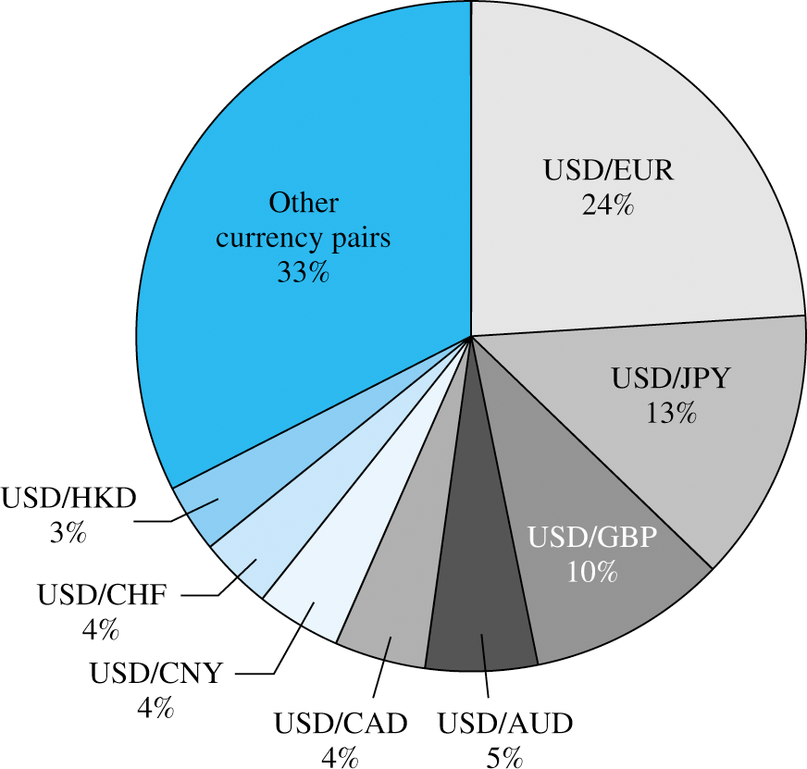

Slide 8
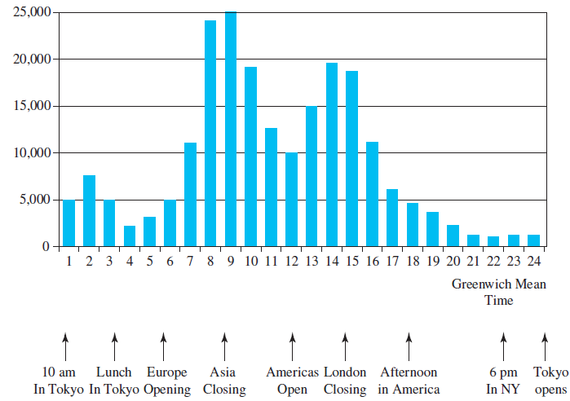
Average Electronic Foreign Exchange Conversations per Hour (Monday–Friday, 2001)
5-<number>

Slide 9
Correspondent Banking Relationships
Interbank market
  Made up of a network of correspondent banking relationships, with large commercial banks maintaining demand deposit accounts (i.e., correspondent banking accounts) with one another
  Correspondent bank account network facilitates the efficient functioning of the FX market
5-<number>

Slide 10
Correspondent Banking Communications
International commercial banks communicate with one another using:
  SWIFT: Society for Worldwide Interbank Financial Telecommunications.
  CHIPS: Clearing House Interbank Payments System, in cooperation with US Federal Reserve Bank process over 95% of US dollar payments between international banks.
  ECHO: Exchange Clearing House Limited
    Multi-lateral netting of each currency
5-<number>

Slide 11
Spot Market
Spot market involves almost immediate purchase or sale of foreign exchange
One can buy (take a long position) or sell (take a short position) foreign exchange
Cash settlement is usually made in two business days after the transaction for trades between the U.S. dollar and a non-North American currency
5-<number>

Slide 12
Spot Rate Quotations
Spot rate currency quotations can be stated in direct or indirect terms
  Direct quotations refer to the price of one unit of a foreign currency in terms of the domestic currency
  Indirect quotation is the price of one domestic currency in terms of a foreign currency
5-<number>

Slide 13
Interpreting foreign exchange quotations
  Direct Quotation represents the value of a foreign currency in dollars (number of dollars per currency).
    Example: $1.40 per Euro
  Indirect quotation represents the number of units of a foreign currency per dollar.
    Example: €0.7143 per Dollar
    Indirect quotation = 1 / Direct quotation

Slide 14
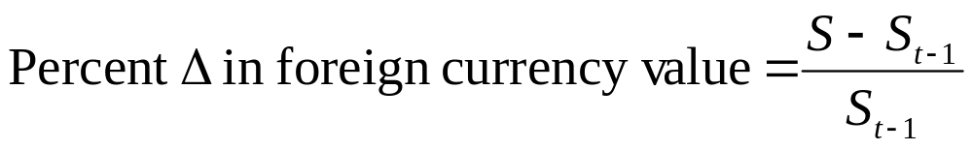
Measuring Exchange Rate Movements
Depreciation: decline in a currency’s value
Appreciation: increase in a currency’s value
Comparing foreign currency spot rates over two points in time, S and S_{t-1}
A positive percent change indicates that the currency has appreciated. A negative percent change indicates that it has depreciated.

Slide 15
Measuring Exchange Rate Movements
For example: Assume the spot rate of the British pound is $1.3613. The expected spot rate one year from now is assumed to be $1.3316. What percentage change does this reflect?

Slide 16
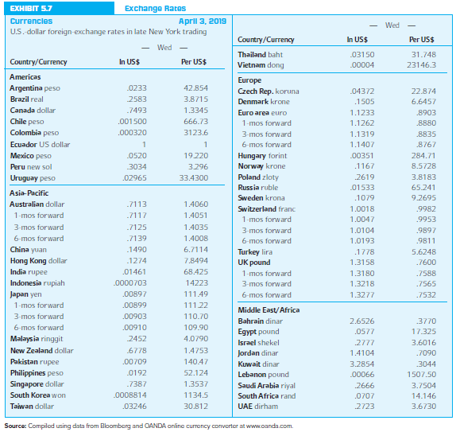
Exchange Rates
5-<number>

Slide 17
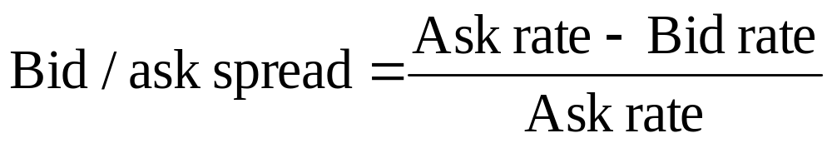
The Bid-Ask Spread
Interbank FX traders buy currency for inventory at the bid price and sell from inventory at the higher offer or ask price
Average of the bid and ask rates are called mid-rates
Bid-ask spread allows dealers to earn a profit
5-<number>

Slide 18
Foreign Exchange Quotations
Banks buy from customers at bid price and sell at ask price
  Example: bid rate for Pounds= $1.52, ask rate = $1.60. You have $1,000 and plan to visit UK and want money in Pounds. What is the bid-ask spread? How much do you get in Pounds?
    If you cancelled your trip and want to convert the Pounds back to Dollars, how much would you have?
  Suppose you want to travel to Japan and the bid-ask rates are $0.0070 and $0.0074 respectively. What is the bid-ask spread? How much in Yen do you get?

Slide 19
Spot FX Trading
In the interbank market, the standard size trade is about $10 million
Bid-ask quotes are normally four decimal places (e.g., $1.3153)
  $1.31 is known as the bid quote big figure and assumed to be known by all traders
  Last two digits (.53) is the small figure
5-<number>

Slide 20
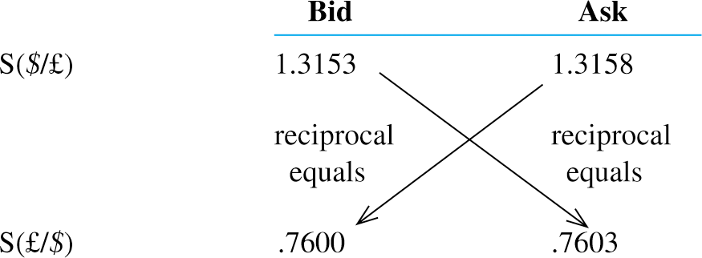
Bid-Ask Spread for ₤
Direct – Indirect quotes

Slide 21
Bid-Ask Spread for ₤
Sª ($/₤) = 1/ S^{b}(₤/$)
Sª (₤/$) = 1/ S^{b}($/ ₤)

Slide 22
Spot Rate Quotations (Continued)
Cross-exchange rate is an exchange rate between a currency pair where neither currency is the U.S. dollar
5-<number>

Slide 23
Cross-Rate Trading Desk
Currency against currency trade is when a customer wants to trade out a nondollar currency for another nondollar currency
  For example, a customer wants to trade out of British pounds into Swiss francs
  Typically handled by the bank selling British pounds for U..S dollars and then selling U.S. dollars for Swiss francs
  Handled at the cross-rate desk of the bank
5-<number>

Slide 24
Cross-Rate - example
S(€/₤) = S($/₤) / S($/€)
Suppose, ₤1.00 costs $1.3158 and €1.00 costs $1.1233 then the cost of ₤1.00 in euros =
5-<number>

Slide 25
Cross-Rate - example
S(€/₤) = S($/₤) x S(€/$)
Suppose, ₤1.00 costs $1.3158 and $1.00 costs € 0.8903 then the cost of ₤1.00 in euros =
5-<number>

Slide 26
Movements in Cross Exchange Rates
If currencies A and B move in same direction, there is no change in the cross exchange rate.
When currency A appreciates against the dollar by a greater (smaller) degree than currency B, then currency A appreciates (depreciates) against B.
When currency A appreciates (depreciates) against the dollar, while currency B is unchanged against the dollar, currency A appreciates (depreciates) against currency B by the same degree as it appreciates (depreciates) against the dollar.

Slide 27
Example on cross-exchange rate appreciation or depreciation
Movements in Cross Exchange Rates. Last year a dollar was equal to 8.5 Swedish kronor, and a Polish zloty was equal to $.240. Today, the dollar is equal to 9.3 Swedish kronor and a Polish zloty is equal to $.25. By what percentage did the cross exchange rate of the Polish zloty in Swedish kronor (that is, the number of kronor that can be purchased with one zloty) change over the last year?

Slide 28
Example
Movements in Cross Exchange Rates. Last year a dollar was equal to 19.45 Mexican Peso, and a Canadian Dollar was equal to $.80. Today, the dollar is equal to 20.45 Mexican Peso and a Canadian Dollar is equal to $.84. By what percentage did the cross-exchange rate of the Mexican Peso in Canadian Dollar (that is, the number of Peso that can be purchased with one Canadian Dollar) change over the last year?

Slide 29
Bid ask for cross currencies
 | In American terms |  | In European terms
 | Bid | Ask | Bid | Ask
₤, Pounds | $1.3153 | $1.3158 | ₤0.7600 | ₤0.7603
€, Euros | $1.1228 | $1.1233 | €0.8903 | €0.8906

Slide 30
Bid ask for cross currencies
S^{b} (€/₤) = S^{b}($/₤) x S^{b}(€/$)
Sª (€/₤) = Sª($/₤) x Sª(€/$)
S^{b} (₤/€) = S^{b}(₤/$) x S^{b}($/ €)
Sª (₤/€) = Sª(₤/$) x Sª($/ €)

Slide 31
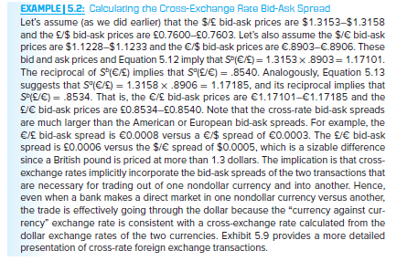
Calculating Cross-Exchange Rate Bid-Ask Spread
5-<number>

Slide 32
Suppose the customer wants to sell ₤1,000,000 for €
Bank will first buy pounds @$1.3153 = $1,315,300
Then bank will buy those dollars and sell € @ €0.8903 = $1,315,300 x €0.8903 = €1,171,012

Slide 33

Suppose the customer wants to sell €1,000,000 for ₤

Slide 34
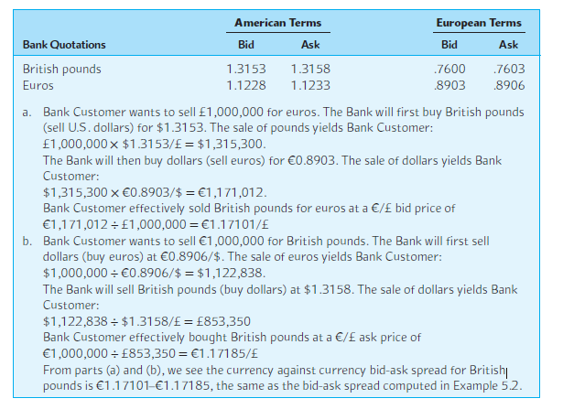
Cross-Rate Foreign Exchange Transactions
5-<number>

Slide 35
Example 2 – cross exchange rate with bid-ask spreads
Compute Bid-Ask spread of pesos/CAD (number of Pesos for each CAD).
 | In American terms |  | In foreign exchange
 | Bid | Ask | Bid | Ask
Pesos | $0.0489 | $0.0493 | 20.30 | 20.45
CAD | $0.6940 | $0.6961 | 1.437 | 1.441
Pesos/CAD

Slide 36
Example 2 – cross exchange rate with bid-ask spreads
Compute Bid-Ask spread of pesos/CAD (number of Pesos for each CAD).
 | In American terms |  | In foreign exchange
 | Bid | Ask | Bid | Ask
Pesos | $0.0489 | $0.0493 | 1/$0.0493 =20.28 | 1/$0.0489 =20.45
CAD | $0.6940 | $0.6961
Pesos/CAD | Pesos14.07 | Pesos14.24

Slide 37
Example 2 – cross exchange rate with bid-ask spreads
Compute Bid-Ask spread of CAD/Peso (number of Canadian dollars for each peso)
 | In American terms |  | In foreign exchange
 | Bid | Ask | Bid | Ask
Pesos |  |  | 20.30 | 20.45
CAD | $0.6940 | $0.6961
CAD/Peso

Slide 38
If you want to convert CAD 100,000 to pesos?
 | In American terms |  | In foreign exchange
 | Bid | Ask | Bid | Ask
Pesos | $0.0489 | $0.0493 | 20.30 | 20.45
CAD | $0.6940 | $0.6961 | 1.437 | 1.441

Slide 39
If you want to convert Pesos 1,000,000 to CAD?
 | In American terms |  | In foreign exchange
 | Bid | Ask | Bid | Ask
Pesos | $0.0489 | $0.0493 | 20.30 | 20.45
CAD | $0.6940 | $0.6961 | 1.437 | 1.441

Slide 40
Triangular Arbitrage
Triangular arbitrage is the process of trading out of the U.S. dollar into a second currency, then trading it for a third currency, which in turn is traded for U.S. dollars
  Purpose is to earn an arbitrage profit via trading from the second to the third currency when the direct cross-exchange rate between the two is not in alignment with the implied cross-exchange rate
  Arbitrage is a zero-risk, zero-investment strategy from which a profit is guaranteed
5-<number>

Slide 41
Triangular Arbitrage
$1.0018 /SFr
¥111.49/$
¥112.20/Sfr
Cross rate = $1.0018 /SFr x ¥111.49/$
= ¥111.69/Sfr ---- Arbitrage exists
5-<number>

Slide 42
Triangular Arbitrage
$1.0018 SFr
¥111.49/$
¥112.20/Sfr
Since you get more ¥ for each SFr,
Use $ to buy SFr and convert SFr to ¥ and then ¥ back to $.
$1,000,000 convert to SFr @ $1.0018
$1,000,000/$1.0018 = SFr 998,203.23 x ¥112.20/Sfr = ¥111,998,402.40/111.49 = $1,004,560.07
5-<number>

Slide 43
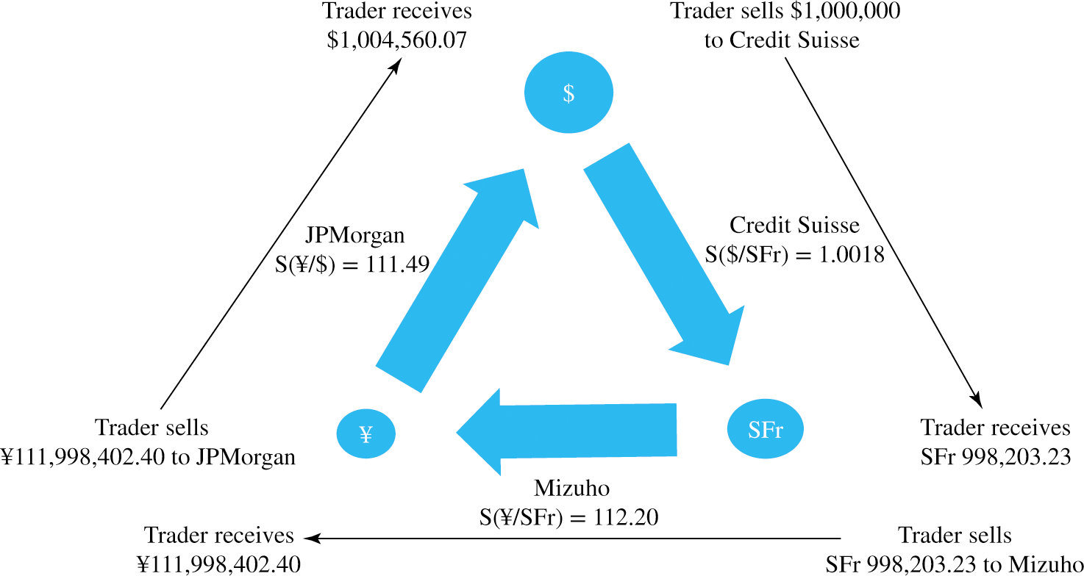

Slide 44
Triangular arbitrage. Example 2
$1.6/₤
MYR8.1/₤
$0.20/MYR

Slide 45
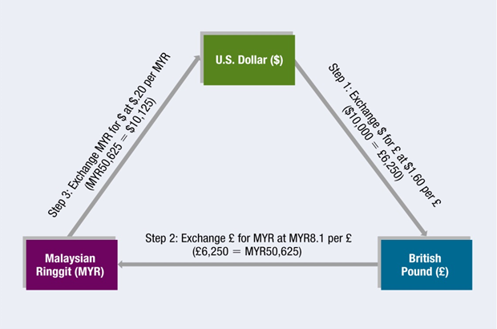

Slide 46
Triangular arbitrage: Example 3
As an example, suppose you have $1 million and you are provided with the following exchange rates: USD/EUR = 1.1586, EUR/GBP = 1.4680, and USD/GBP = 1.6939.

Slide 47
Bid ask for cross currencies
 | Bid | Ask
Bank A | $1.3153/₤ | $1.3158/₤
Bank B | €0.8903/$ | €0.8906/$
Bank C |  | €1.1700/₤

Slide 48
Triangular arbitrage possible
If given Ask price is lower than implied cross bid rate.
OR
Given Bid price is greater than the implied cross ask rate

Slide 49
Implied Bid-Ask spread should have been 1.17101 – 1.17185
Ask price given is lower than implied cross bid rate.
S^{b} (€/₤) = S^{b}($/₤) x S^{b}(€/$) =
Start with $1,000,000, buy euros @ €0.8903.
Buy ₤ using € since it costs you fewer € per ₤
Then convert back to $.

Slide 50
Suppose the ask price = €1.17150/₤
 | Bid | Ask
Bank A | $1.3153/₤ | $1.3158/₤
Bank B | €0.8903/$ | €0.8906/$
Bank C |  | €1.17150/₤

Slide 51
Suppose the ask price = €1.17150/₤
 | Bid | Ask
Bank A | $1.3153/₤ | $1.3158/₤
Bank B | €0.8903/$ | €0.8906/$
Bank C | €1.17250/₤

Slide 52
Example 2-Triangular arbitrage
 | In American terms |  | In foreign exchange
 | Bid | Ask | Bid | Ask
Pesos | $0.0489 | $0.0493 | 20.30 | 20.45
CAD | $0.6940 | $0.6961 | 1.437 | 1.441
CAD/Peso | 0.070011 | 0.070185

Slide 53
Example 3 – cross exchange rate with bid-ask spreads
 | Bid | Ask
Bank A | $0.01154/INR | $0.01184/INR
Bank B | CAD 1.4136/$ | CAD 1.4186/$
Bank C | CAD 0.0151/INR | CAD 0.0155/INR

Slide 54
The Forward Market
Forward market involves contracting today for the future purchase or sale of FX
  No money changes hands upon entering the contract today
  May be used to hedge FX exposure or to speculate in FX market
  Forward price is usually higher (at a premium) or lower (at a discount) than spot price
  Bank quotes for maturities of 1, 3, 6, 9, and 12 months are readily available
5-<number>

Slide 55
Forward Rate Quotations
Forward market involves contracting today for the future purchase or sale of FX
  F_{N} (j/k) is the notation used to refer to the price of one unit of currency k in terms of currency j for delivery in N months
  F notation is used to denote a forward exchange rate
  Like spot quotes, forward quotes are either direct or indirect with one being the reciprocal of the other
5-<number>

Slide 56
Forward Rate Quotations (Continued)
American term Swiss franc forward quotations
  S($/SFr) = 1.0018
  F₁($/SFr) = 1.0047
  F₃($/SFr) = 1.0104
  F₆($/SFr) = 1.0193
European term forward quotations are the reciprocal of the American term quotes
  S(SFr/$) = 0.9982
  F₁(SFr/$) = 0.9953
  F₃(SFr/$) = 0.9897
  F₆(SFr/$) = 0.9811
Example of reciprocal calculations:
1 / 1.0018 = 0.9982
1 / 0.9928 = 1.0018
5-<number>

Slide 57
Forward Premium
Common to express the premium or discount of a forward rate as an annualized percentage deviation from the spot rate
  Forward premium (or discount) is useful for comparing against the interest rate differential between two countries
  Forward premium or discount can be calculated using American or European term quotations
5-<number>

Slide 58
Forward Premium (or discount)
Forward premium (or discount) =
[ F_{N}($/j) - S($/j) ] / S($/j) x 360/n
Where j is any foreign currency and n = number of days in the forward contract.
5-<number>

Slide 59




Forward Cross-Exchange Rates
5-<number>

Slide 60
Non-Deliverable Forward Contracts
Due to government-instituted capital controls, currencies of some emerging market countries are not freely traded
  Not possible to obtain these currencies offshore in the spot market to settle a forward position
  For many of these currencies, trading in non-deliverable forward (NDF) contracts exists
5-<number>

Slide 61
NDF
NDF contracts, unlike a deliverable forward (DF), is settled in cash at the difference between the spot exchange on the maturity date of the contract and the NDF rate times the notional amount of the contract
For example: Long position in NDF Yuan12,000,000 and a forward price of $0.1653/CNY. If the spot price at maturity =$0.1658, then the NDF would be settled by receiving ($0.1658-$0.1653)*12,000,000 = $6,000.
Usually settled in USD.

